Slide 1
Project –problem statement
A us based comapany wants to enter in Austrelian real estate market.company
Company proparty and sell at high price.they have decided to build a machine learning context they have collected some data point in the csv file.
Basic on collected data,a machine learnning model to be built and need below important things to revealed.
Which variable are important to predict the price of variable How do these variable are important to predict the price of variable describe the price of house?
Once model is built it will be used by the management to see how prices very with the variable so that we can make their strategy and make profit. Model will also make them help to understand the market dynamics.
Notes:
EDA

Slide 2
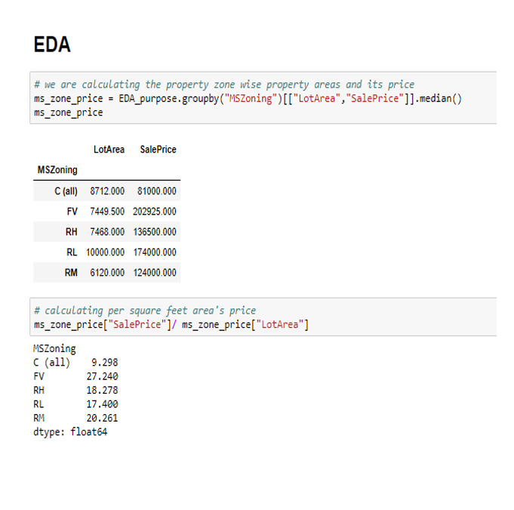
EDA
Floating village residential category price is high as compared to other catogery as per the defination is a special area where a retirement community was developed abd have the highest median price 31.73 squre per feet
People love peace but it is not the case with everyone some people love to high density area I am assuming that everything which is necessary for daily life is a easily available as compared to low density area and prices are also define accordingly by nature if everything ia accessible easily prices wil be high for that place we can see the same affect here in data as well.Average RH price per squre feet is 18.27 and for RL is 17.40 per squre feet we see that RM price is high as compared to RH considering several factor like easy access to things ,low noise population low air population,less crowd etc.

Slide 3
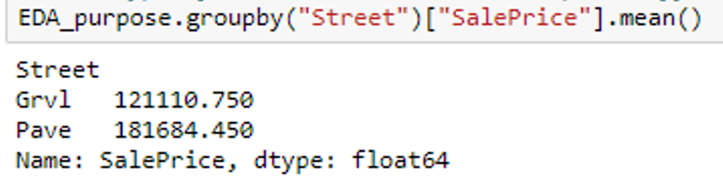
Since poved road looks more durable as compared to gravel road and if property is on side of that road and any society has access to it prices would definitely going to be high and we can see the same here as well in the data

Slide 4
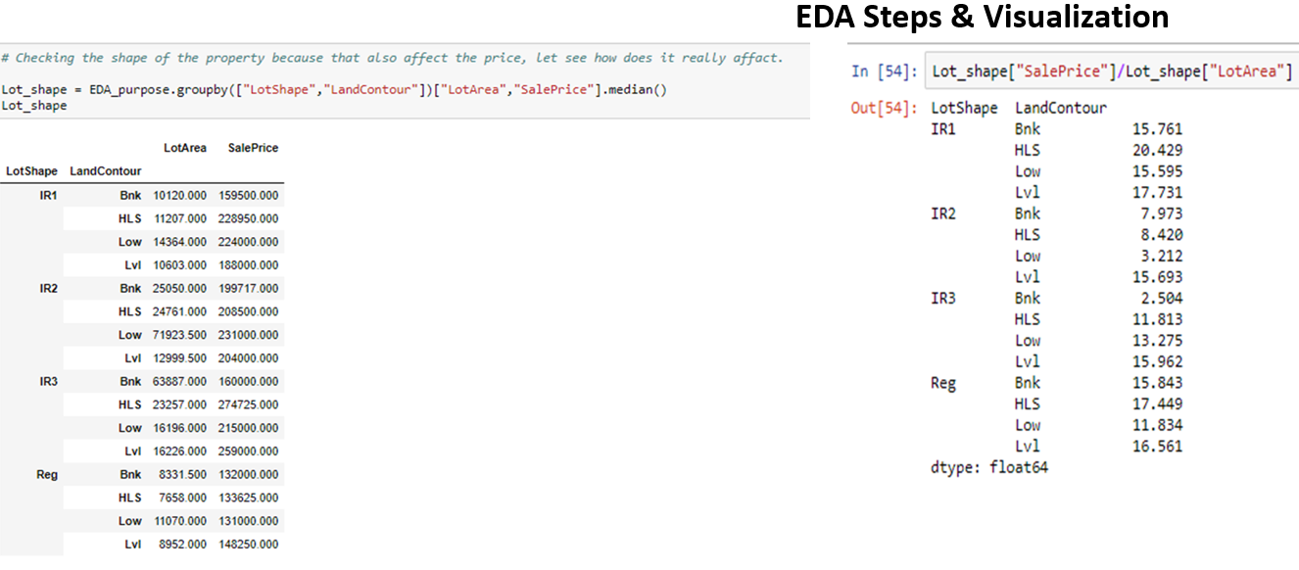
It tried comparing land shape and their level of flatness and checking the price I have found that regular share aand slightly irregular shape are liked and their prices are also high

Slide 5
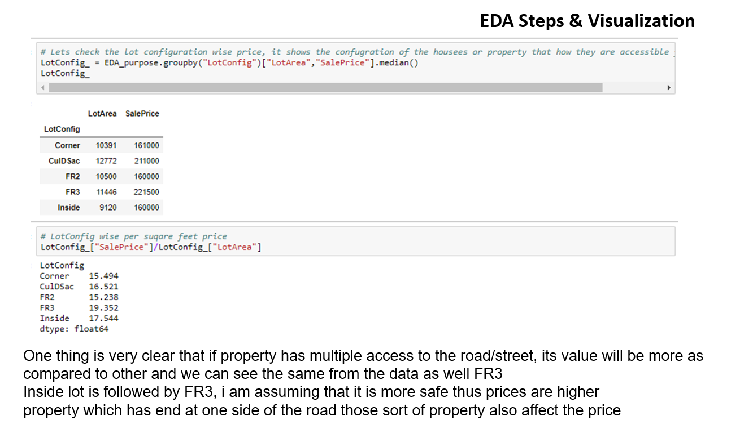

Slide 6
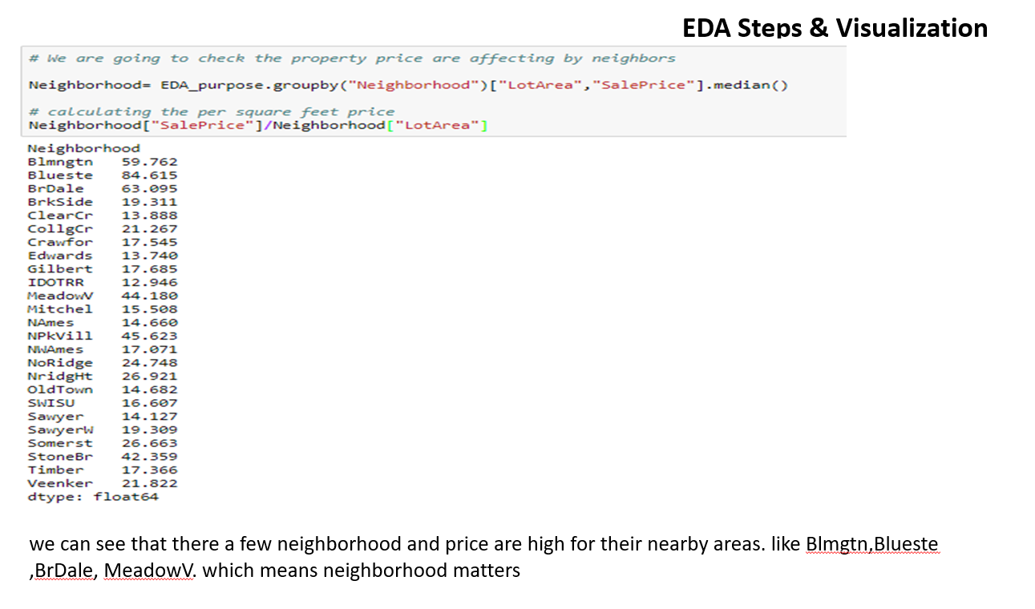

Slide 7
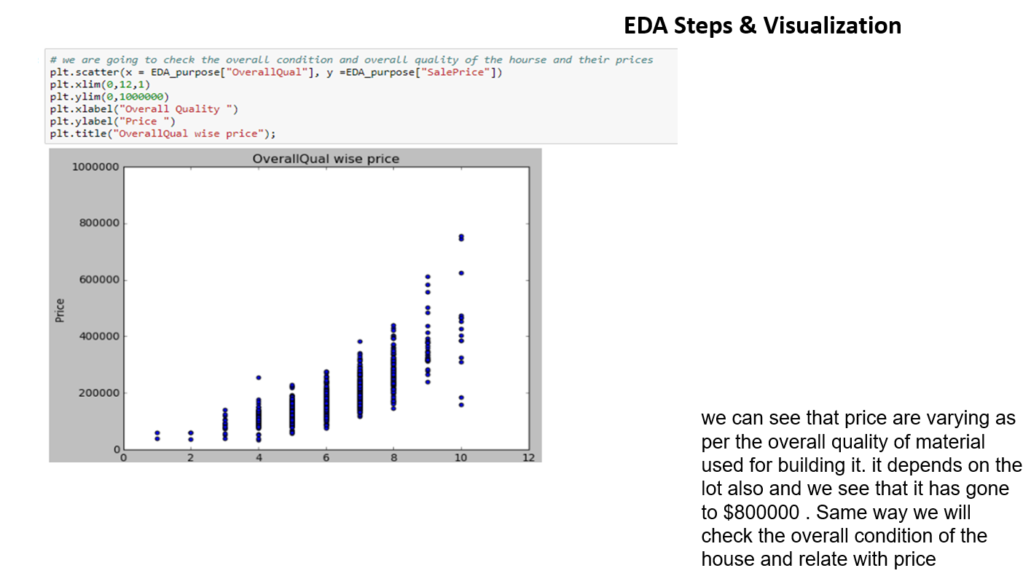

Slide 8
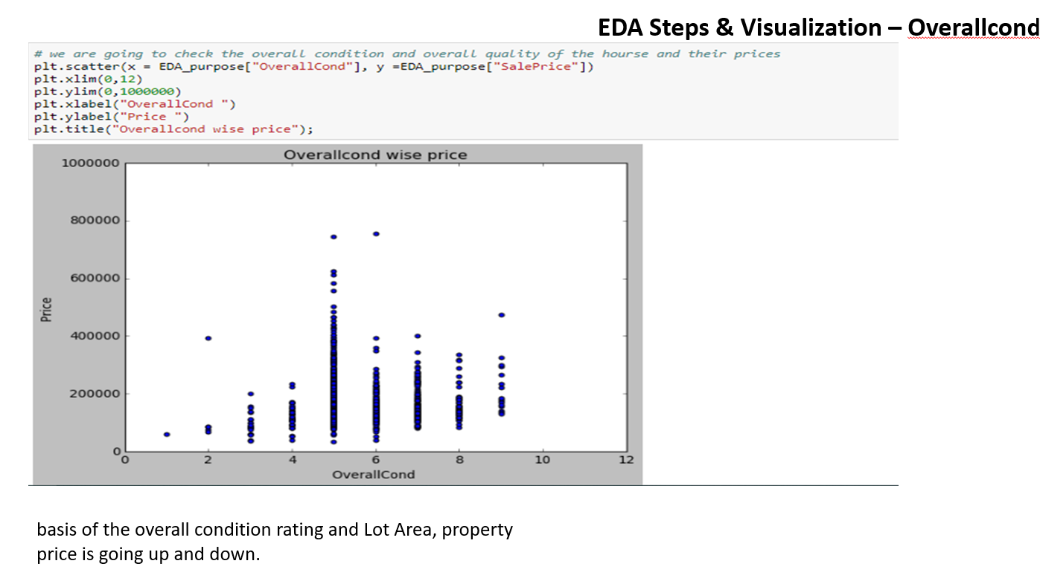

Slide 9
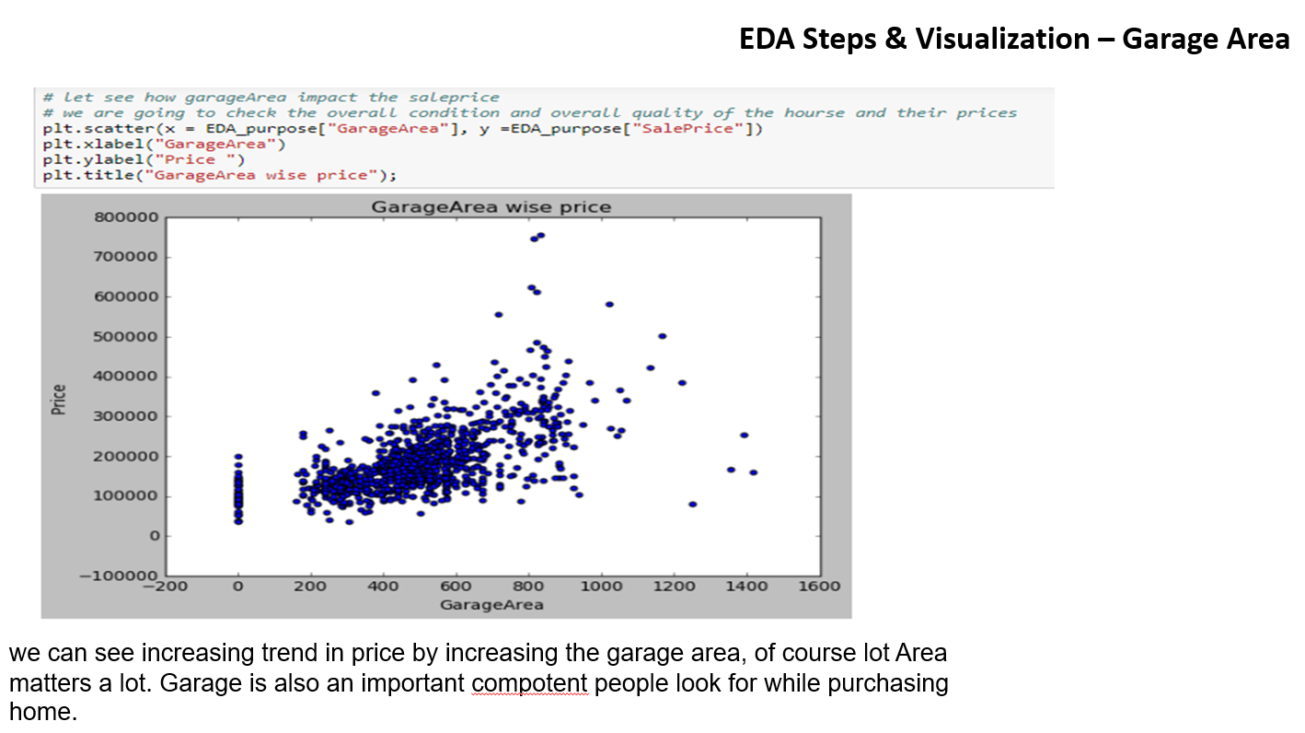

Slide 10
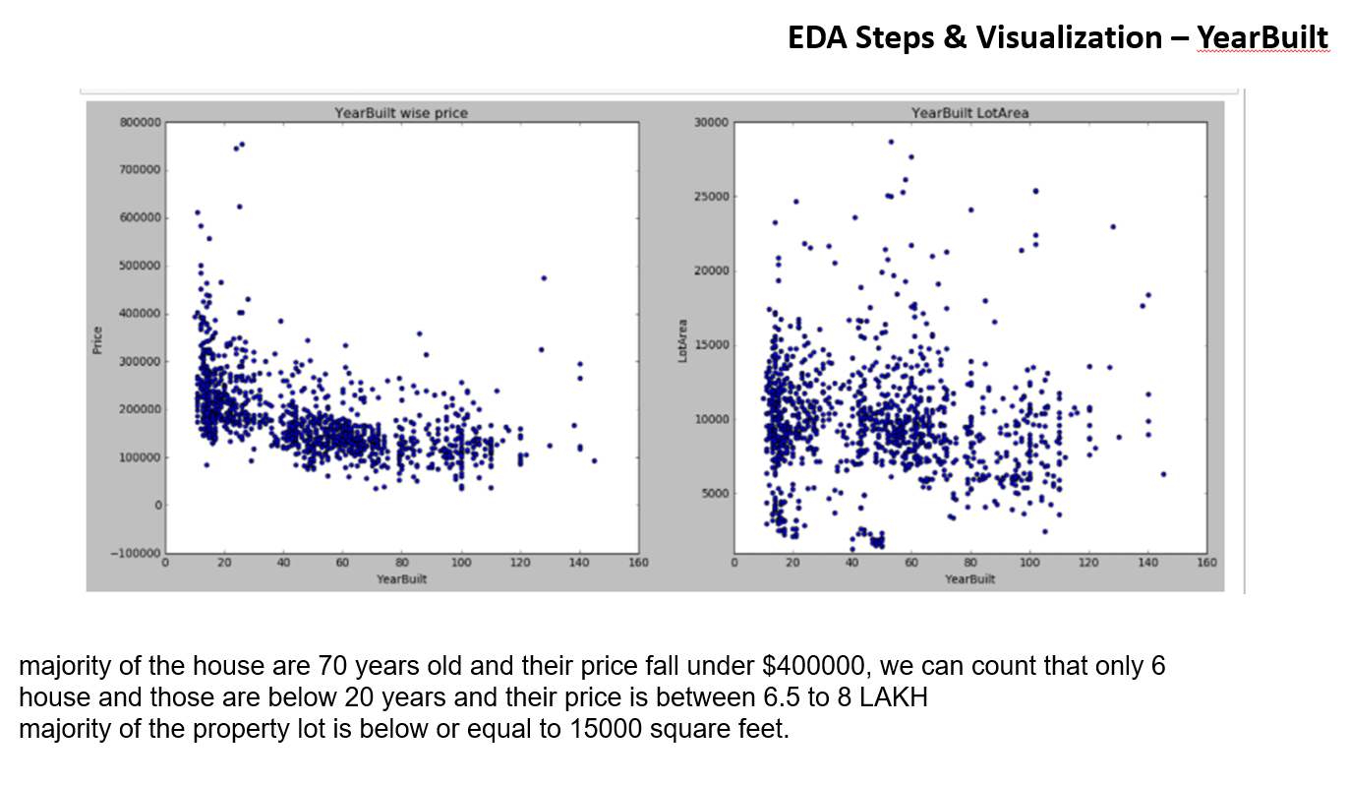

Slide 11
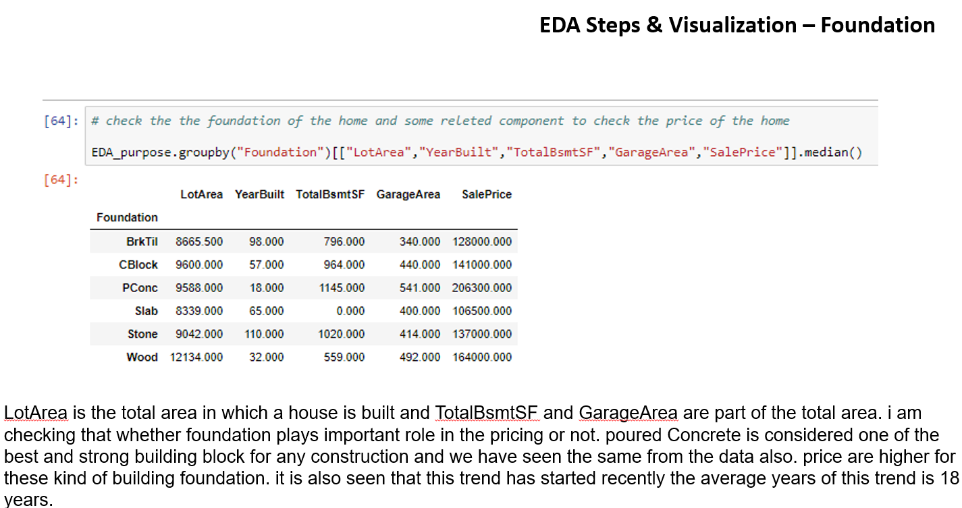

Slide 12
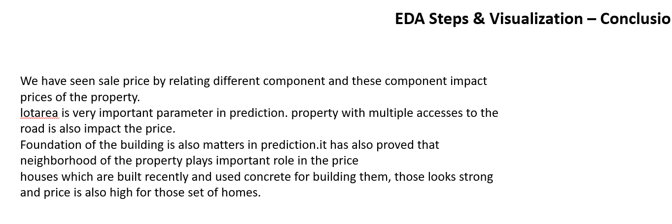

Slide 13
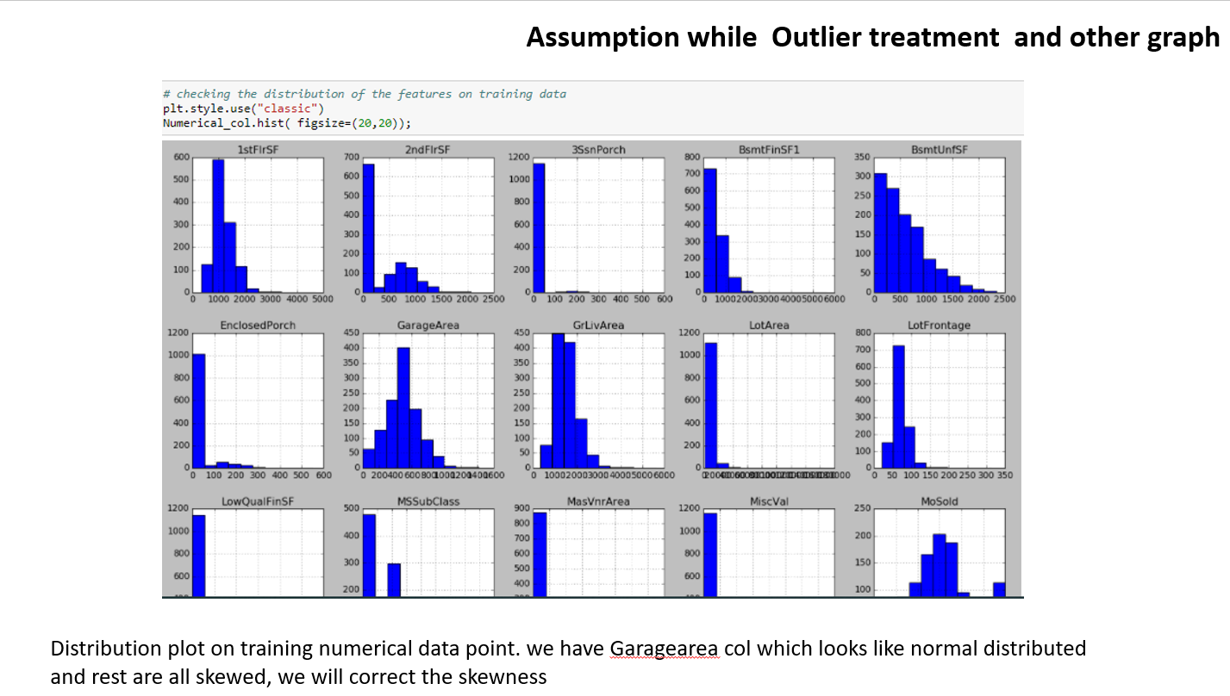

Slide 14
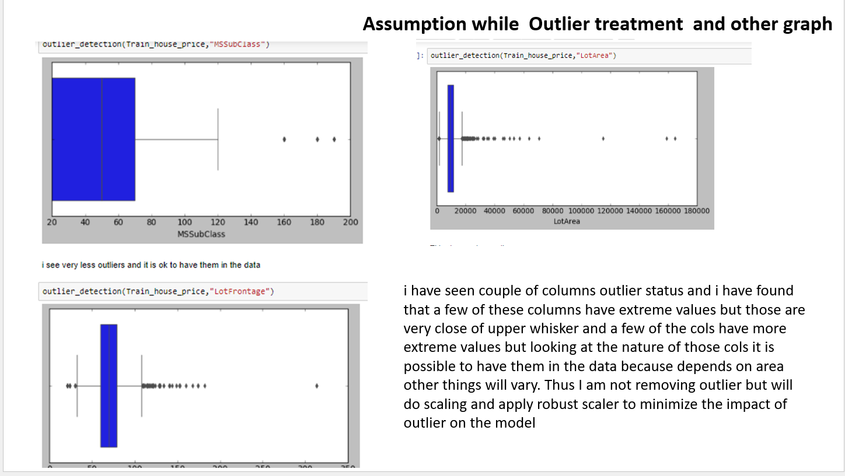

Slide 15
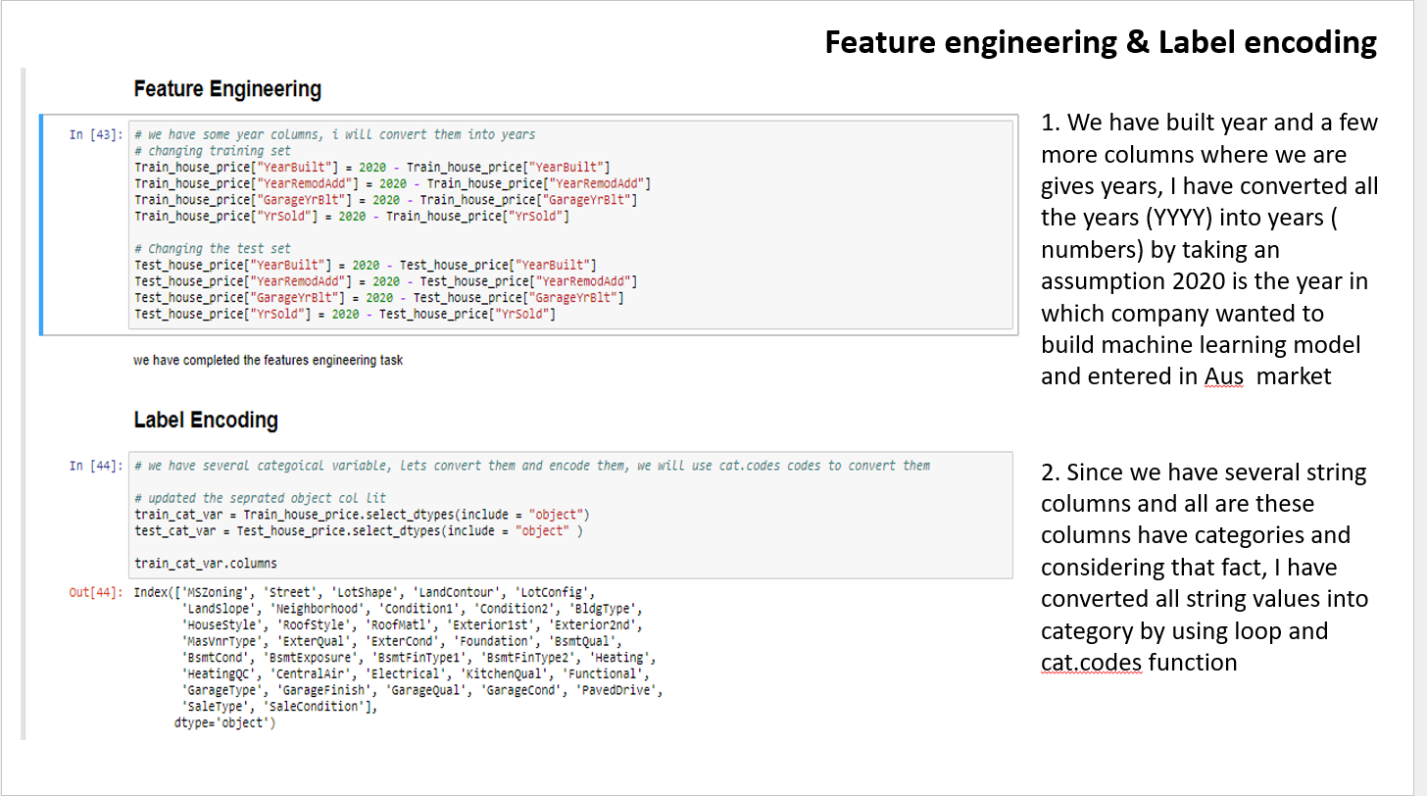

Slide 16
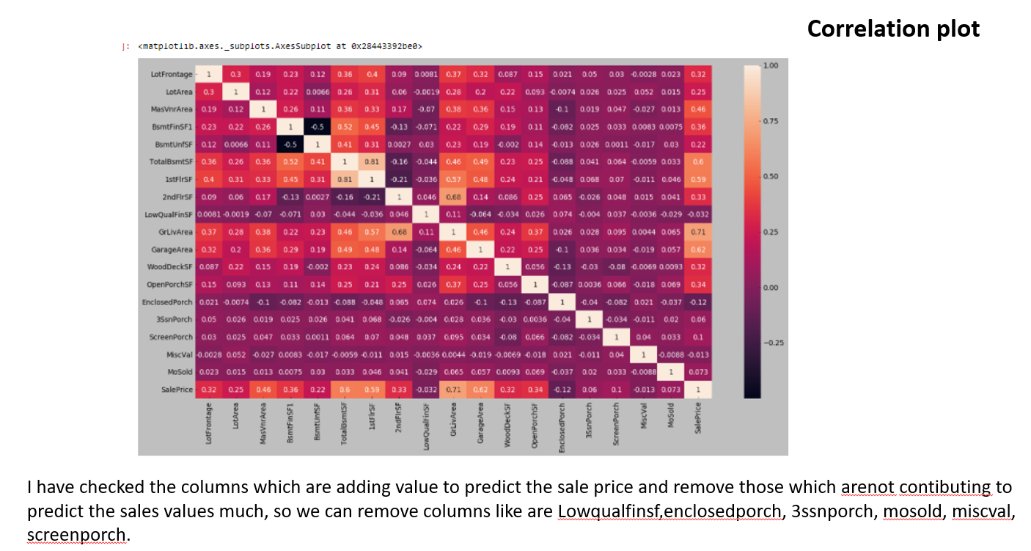

Slide 17
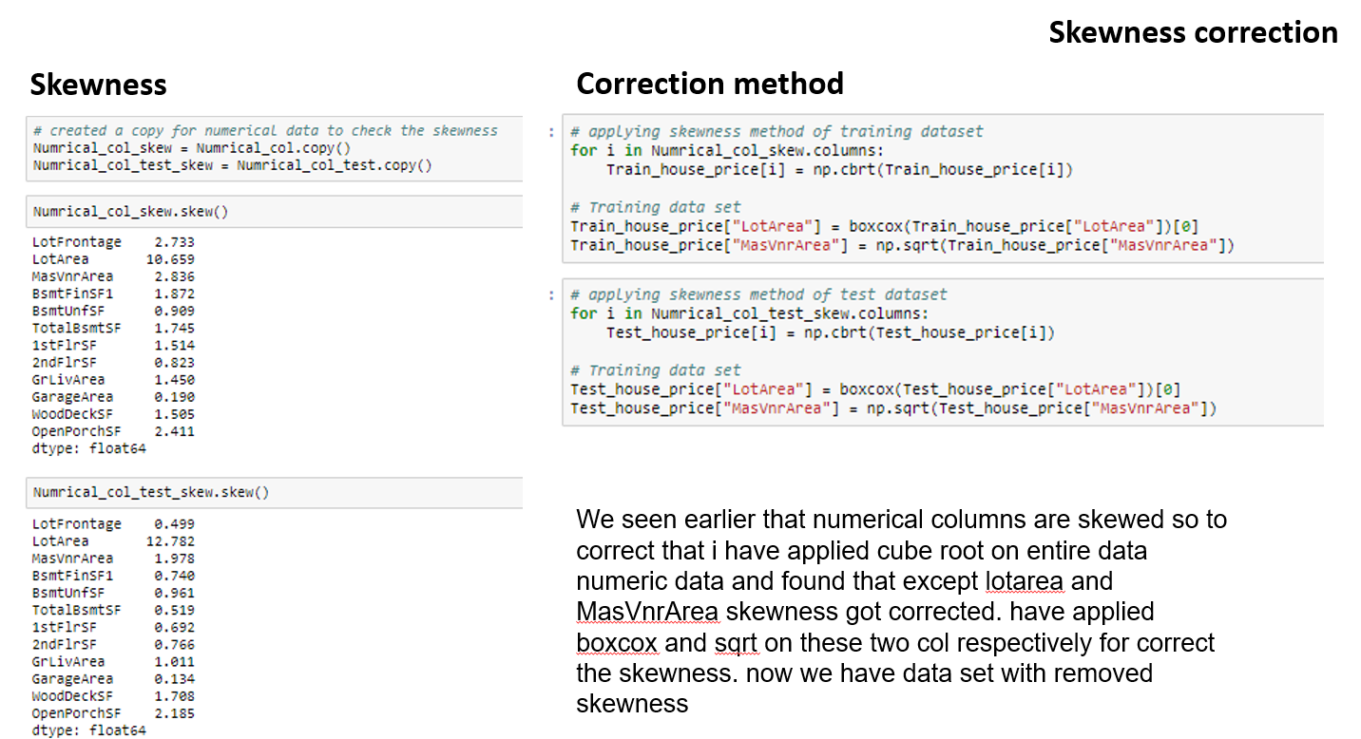

Slide 18
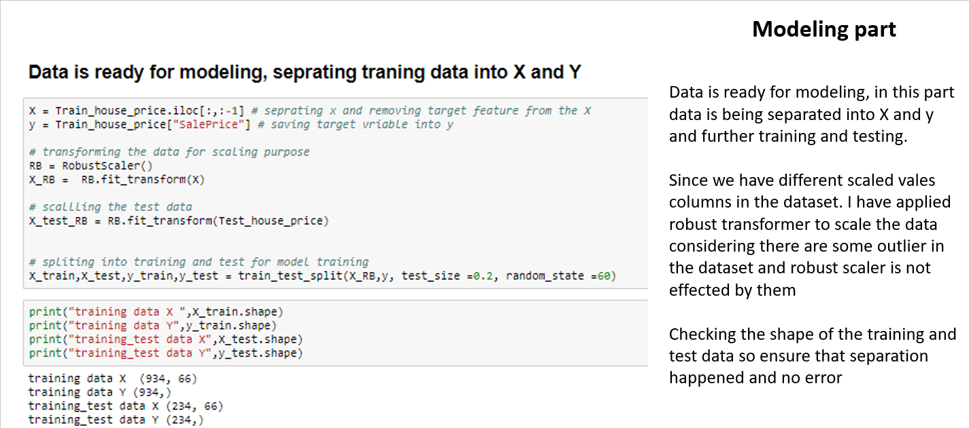

Slide 19
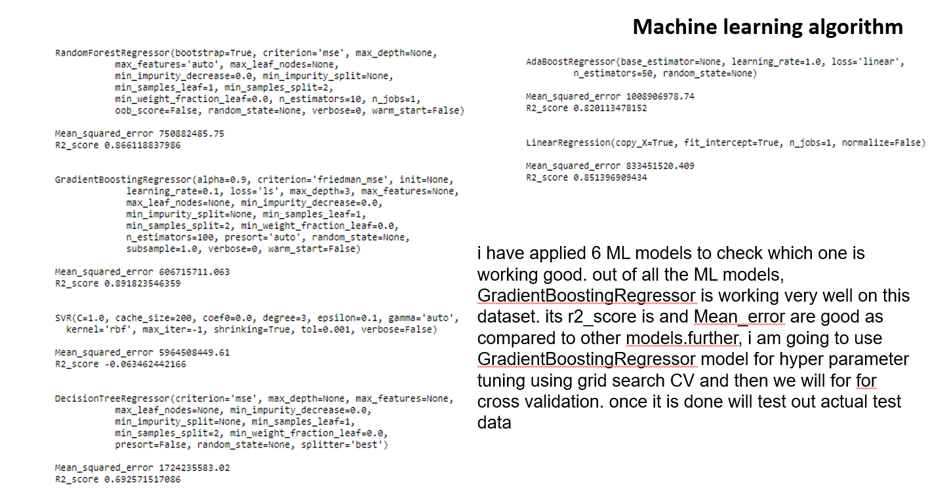

Slide 20
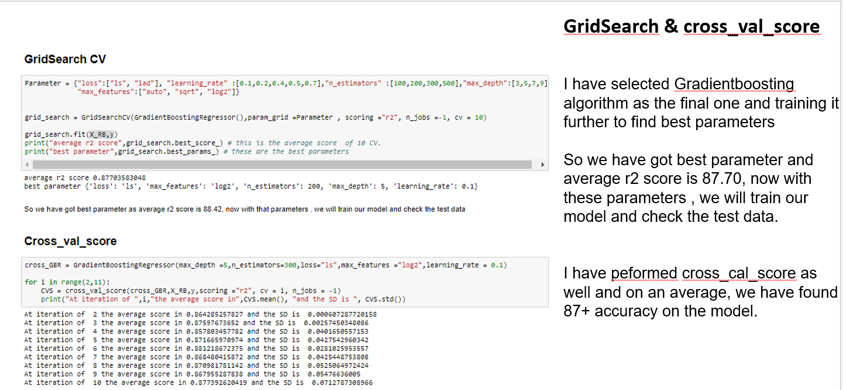

Slide 21
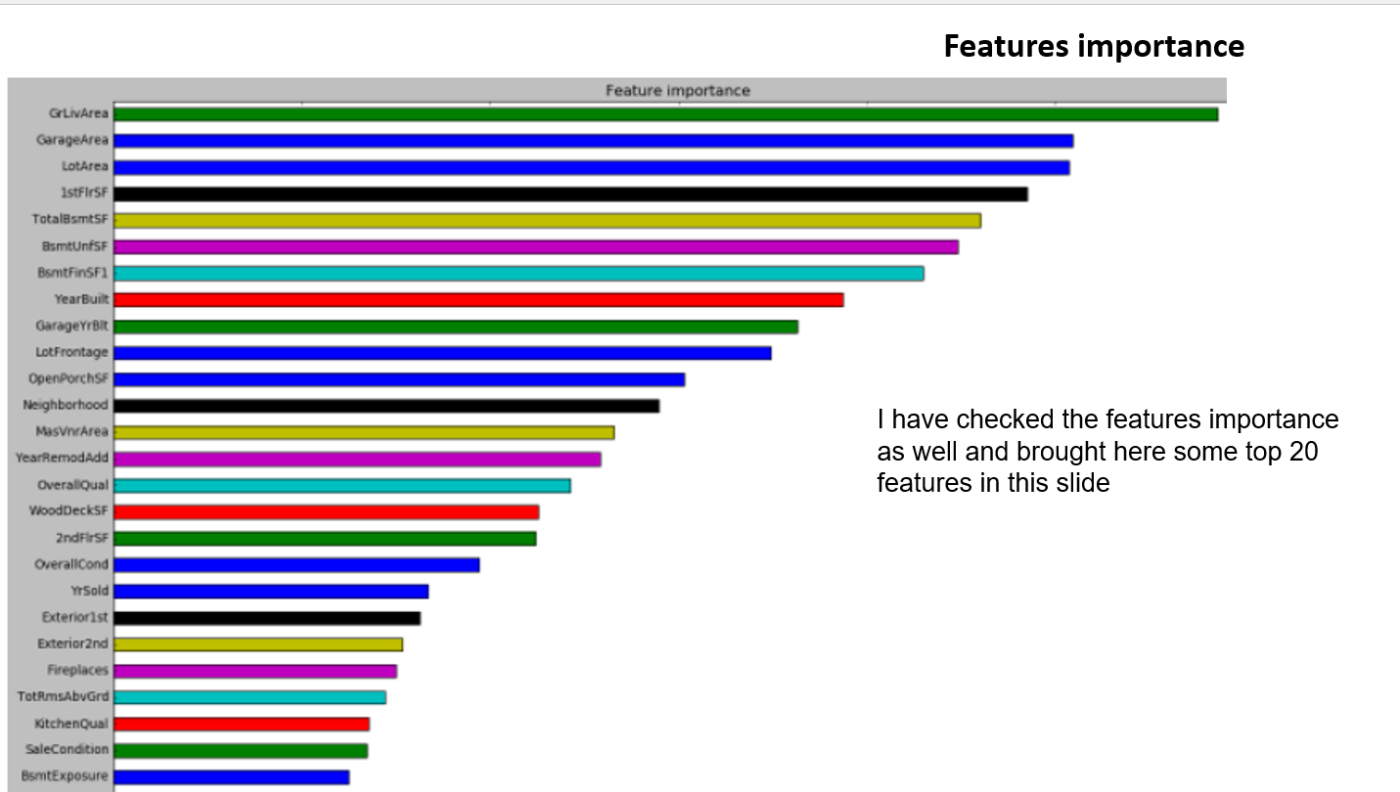

Slide 22
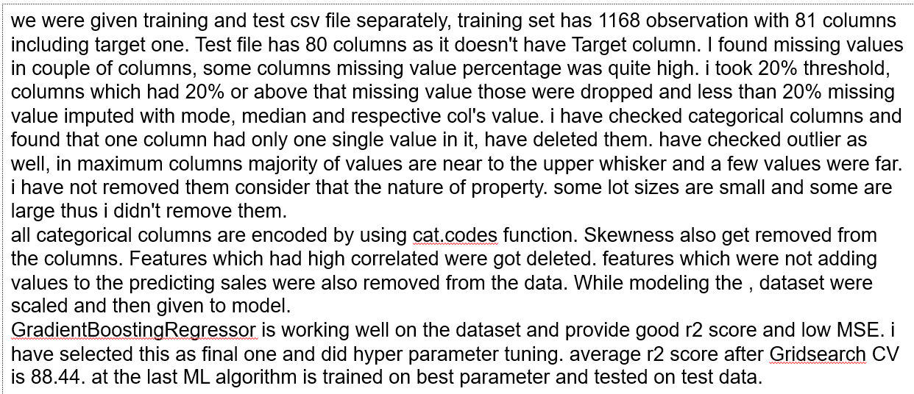

Slide 23
Thank you

